Slide 1
Learning Unsupervised Representations for Sensing Humans with mmWave Radars
Nakul Singh and Aadesh Madnaik

Slide 2
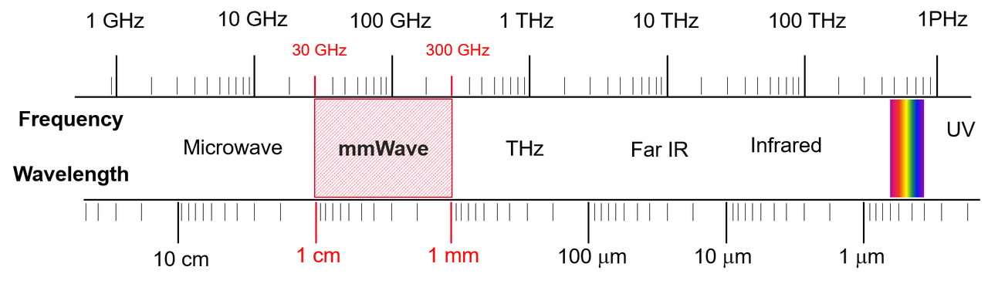
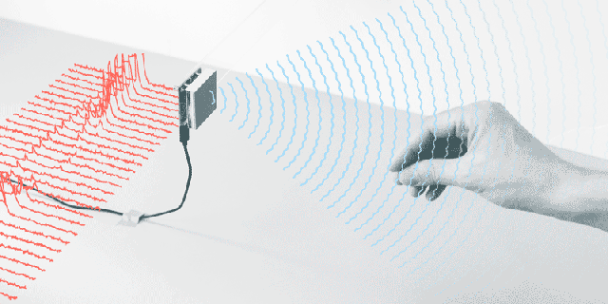
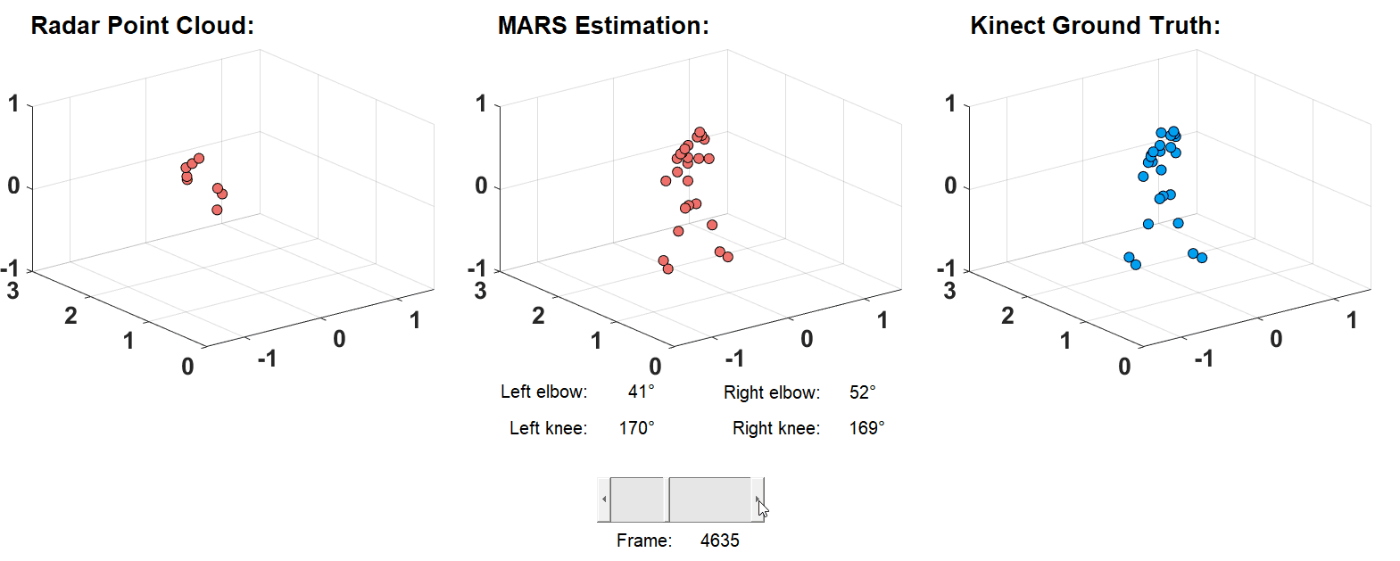
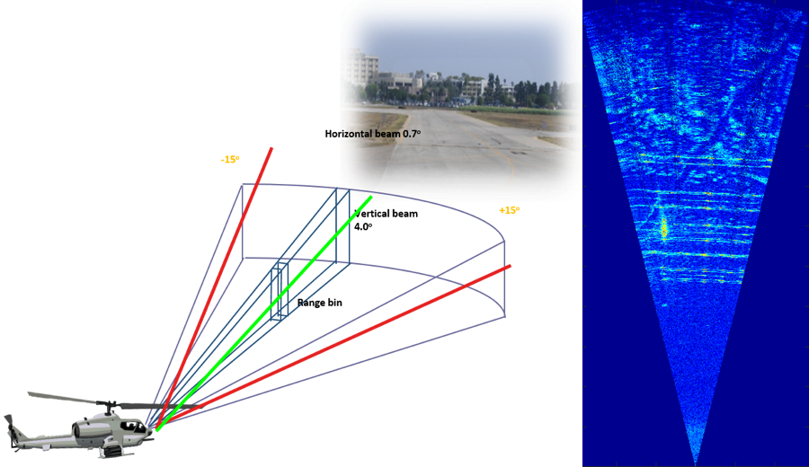
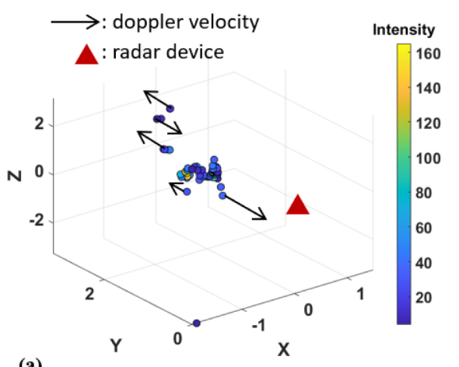
What are mmWave Radars?
mmWave: 60 GHz
  Communication + Sensing
Detection using reflected signals
Comm. systems
5D Data – (x, y, z, Doppler, Intensity)

Slide 3
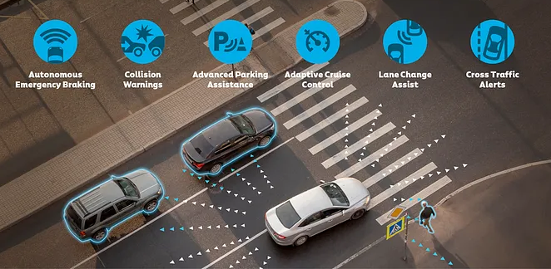
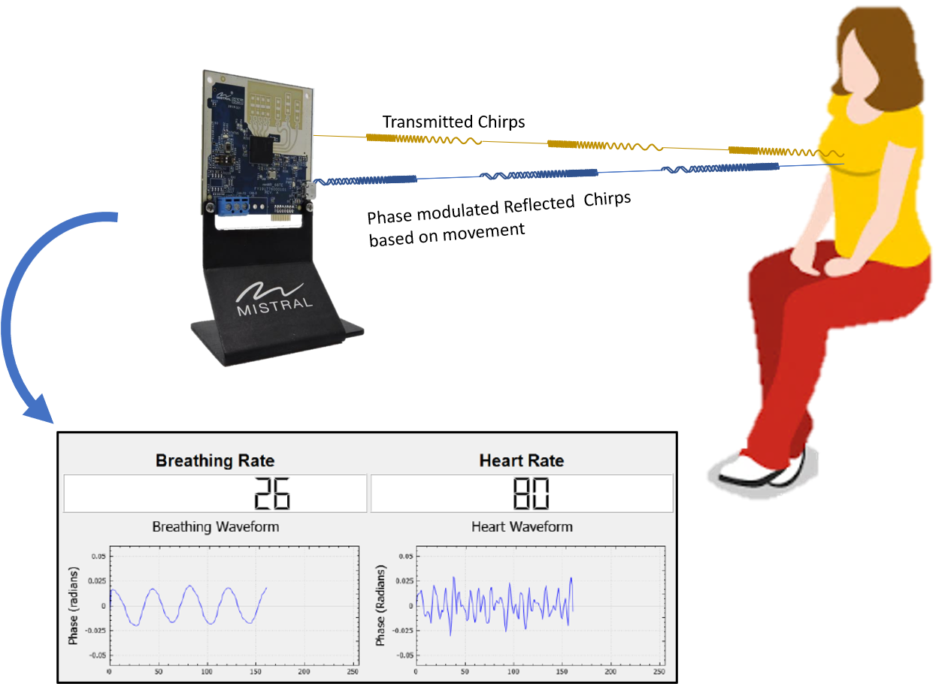
Motivation
mmWave as a sensing modality:
  Commonly deployed on cars (warning systems), military applications
  Privacy preserving, low-cost
Prospective uses:
  Rehabilitation systems
  Fall detection
  Non-contact vital monitoring
mmWave radar data is easy to obtain, but difficult to process
Several uses without a unifying framework!
Notes:
Adaptive cruise control, early braking systems, blind spot monitoring etc
Robust to weather conditions

Slide 4
Approach
Prior Work | Goals | Advantages | Disadvantages
PointNet | Classification, Semantic Segmentation | Generic Model for Point Cloud data | Needs labelled data
MARS | Mapping to skeleton model | Baseline | Needs labelled data
TGUL | Task-Agnostic Feature Extraction through ROI | Unsupervised framework | Does not work for 5D Point Clouds, Different kind of RF data
Balancing the pros and cons of prior work
Unsupervised learning: No labelling, generalized framework
Supervised learning: Task-specific framework

Slide 5
Overall Approach
Fusing Unsupervised and Supervised
Network which learns representations
Used for downstream supervised tasks
Skeleton Model
Task-specific network
Learning Represent-ations
Right lunge
Left lunge
Squat
Right hand extension
…
Pose Classification
Latent Features
Task-specific network
Task-specific network
Alice
Bob
Claire
…
Encoder
(unsupervised)
Person
Identification
Point Cloud Stream
(supervised)

Slide 6
Approach for Learning Features
Point Cloud processing must be
Invariant to rotation, scaling, etc
Preserve spatial correlation
Take Doppler and Intensity into consideration
Robust to noisy input
Autoencoder based on PointNet
Practical considerations
Padding data with points from the same frame
Select points with the highest intensity
Encoder
Latent Features
Decoder
Point Cloud Stream
Learning
Representations
Unpacking
Representations
Notes:
1 and 2: Transforms which preserve the spatial relatedness of points
3: Doppler directly correlated to the velocity of movement and Intensity correlates to the size of the object. Impact the final latent features
4: mmWave data is extremely noisy
Consider only 196 top points in the dataset

Slide 7
Approach for Task-Specific Learning
Creating Skeleton Model from learned features
19 joints * 3 coordinates = 57 quantities - FIXED
Task-specific Network:
  Simple, fully connected MLP
Training data: 500 frames. Down from 24,000!
Encoder
Task-specific network
Latent Features
Point Cloud Stream
Simple, fully connected MLP
Skeleton Model

Slide 8

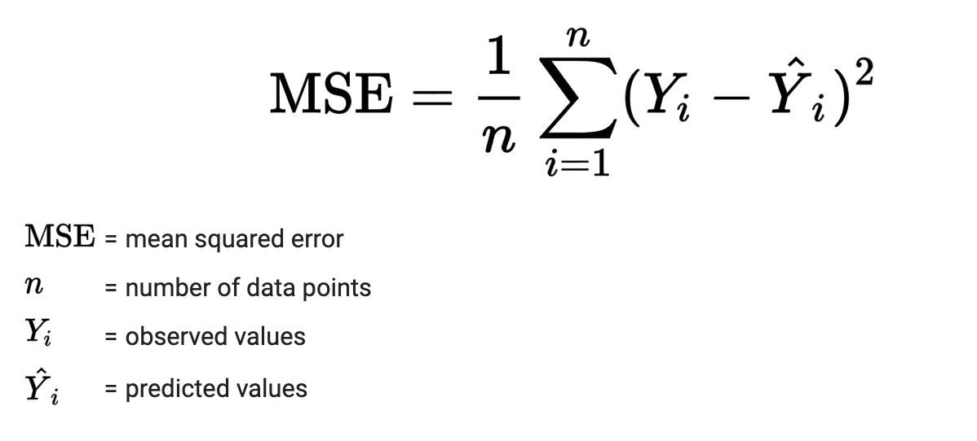
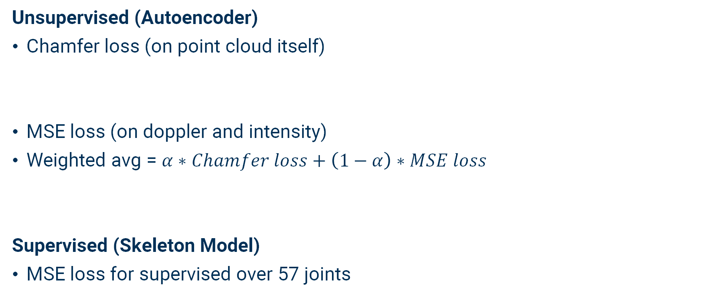
Experiments/Theory
Unsupervised (Autoencoder)
Chamfer loss (on point cloud itself)
MSE loss (on doppler and intensity)
Weighted avg = $α∗Chamfer loss+\left(1−α\right)∗MSE loss$
Supervised (Skeleton Model)
MSE loss for supervised over 57 joints

Slide 9
Sample Results
Baseline trained on 24,000 frames
We train on 500 frames!
50 times reduction
in data requirement (labelled)

Slide 10
Experiments/Theory 2
Comparison of Validation loss of supervised model with trained and untrained encoder
Average error in estimation of joint position < 10 cm
  Comparable to prior work
Clear stagnation in loss

Slide 11
Summary and Conclusions
In this project, we have achieved goals:
Understood the shortcomings of prior work
  Need for a lot of labelled training data
  Inability to be generalized to different tasks
Built an autoencoder to learn the representations of point clouds
  Specific to mmWave radar point clouds
Task-specific learning to map to skeleton model
Through this project, we can conclude:
Models that use the same type of data need to first learn important aspects (representations), then make inferences (task-specific)
Limited training data no longer a problem
mmWave radar Point Clouds are noisy BUT can still work with conventional models
Notes:
Specific = doppler and intensity

